Slide 1










Splitwise Application
Sanketh N S 221IT060
Vrushank T S 221IT083
Nithin S 221IT085
Jay Chavan 221IT020

Slide 2






Topic Selection
Splitwise is a popular application used for splitting bills and expenses among groups of people. It simplifies the process of tracking shared expenses, such as rent, utilities, groceries, meals, and travel expenses, among friends, roommates, or colleagues.
In this project we will be delving into a real-world scenario that involves managing complex relational data and transactions

Slide 3
Problem Description
The problem addressed by the Splitwise project revolves around managing and tracking shared expenses among multiple users efficiently.
User Management
Implementing a user management system where users can register, log in, and manage their accounts. This involves handling user authentication and authorization.

Slide 4
Expense Manangement
Developing features for creating, updating, and deleting expenses. Each expense typically includes details such as the amount, description, date, category, and participants involved.
Group Manangement
Supporting the creation and management of groups, where users can invite others to join and share expenses within the group.

Slide 5
Expense Splitting
Implementing algorithms to calculate how expenses should be split among participants. This can involve various splitting methods, such as equal split, percentage split, or custom split based on specific criteria.
Transaction Recording
Keeping track of transactions between users within a group. This includes recording payments made by individuals to settle their debts and updating the balances accordingly.

Slide 6

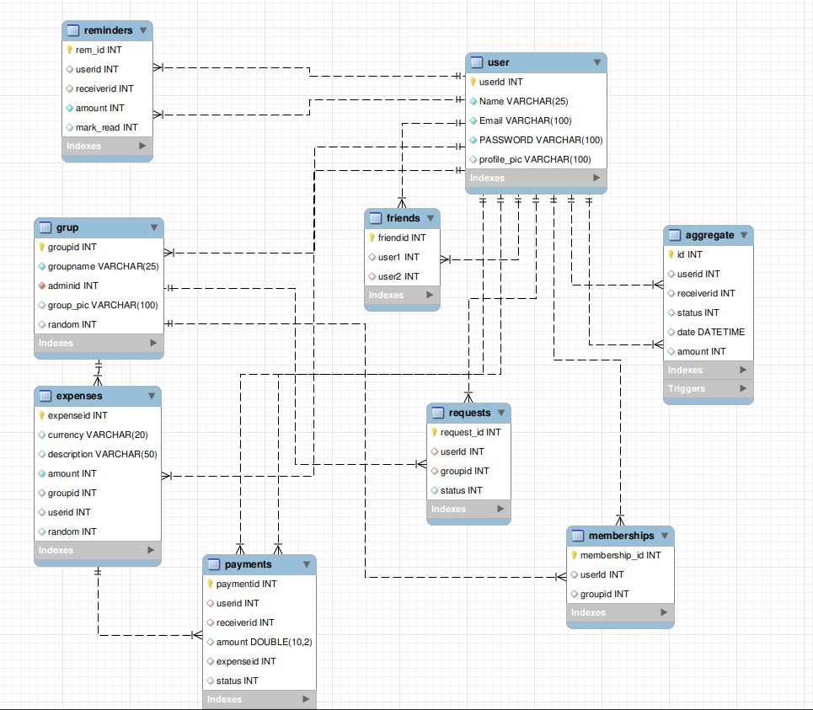

Database Schema

Slide 7
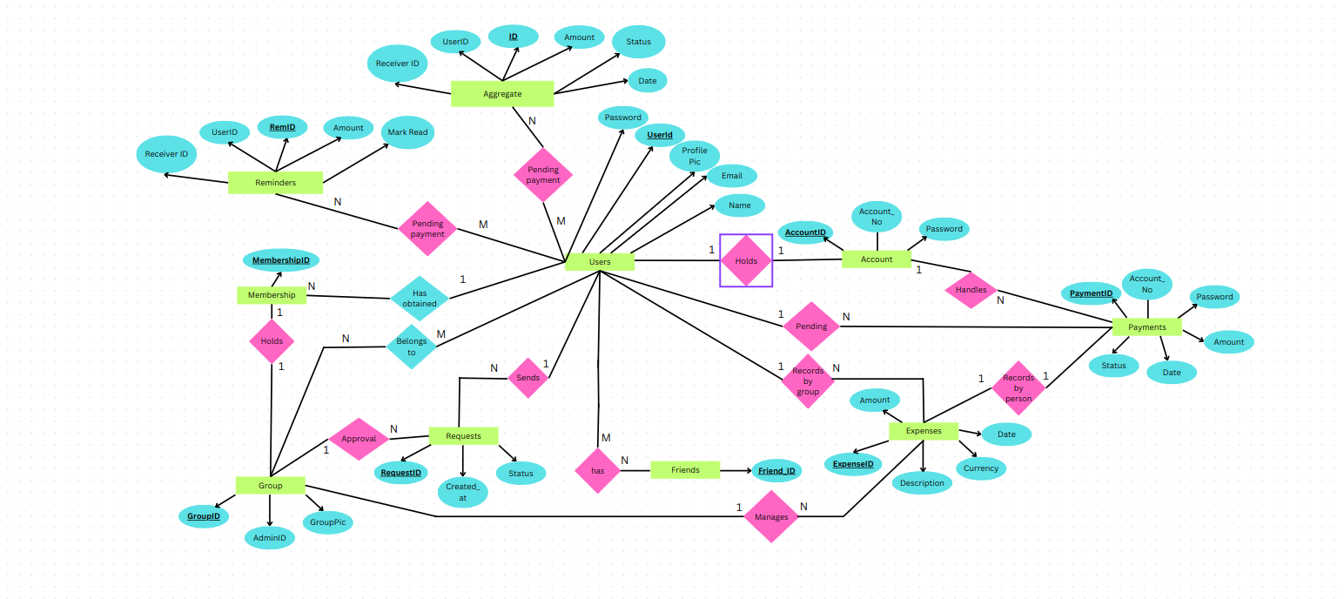
Entity Relationship Diagram

Slide 8
Methodology
User Registration
To access Splitwise, users must first sign up on the website using their email address and a password. This ensures that only authorized users can use the app and access its features securely.
Group Creation and Administration
Once registered, users can create groups for different circles of friends or activities. The person who creates the group becomes its admin, with the ability to manage group members and oversee expenses.

Slide 9
Expense Creation and Division
Group admins can create expenses within Splitwise, specifying the total amount and how it should be divided among members. Whether splitting costs equally or based on custom ratios, the app handles the calculations effortlessly.
Monitoring Pending Payments
Splitwise helps keep track of who owes what within a group. If someone has an outstanding balance, they can settle it directly with the group admin through the app, ensuring transparency and accountability.

Slide 10
Friend Preferences
When admins add new members to a group, Splitwise differentiates them as ‘friends’ from stranger users and allows users to make one-on-one payments to friends within the app thus enabling individuals to handle personal transactions separately from group finances.

Slide 11
Implementation
Database Management
The MYSQL tables used in Splitwise:
Account: User account information such as email, passwords.
Expenses: Expenses incurred within groups, including descriptions, amounts, currencies, and dates.
Friends: User IDs for mapping friend connections.
Groups: Group management information such as group names, administrator IDs, group profile pictures.
Users: User profile information, including names, email addresses, passwords, and profile pictures.

Slide 12
Memberships: Associations between users and the groups they belong to.
Payments: Transactions between users, including details such as expense IDs, payer IDs, receiver IDs, amounts, statuses, and dates.
Requests: Joining group requests initiated by users.
Aggregate: Centralized repository for storing aggregated data related to user transactions within the group.
Reminder: Track reminder details such as the involved parties’ IDs, the amount associated with the reminder, and a flag to mark if the reminder has been read, ensuring timely notifications.

Slide 13
Web Functionalities
Add Group: Creation of a new group entry.
Group Details: Display the group details, create a new expense within the group and invite new members to the group.
My Groups: Display a list of groups to which the user belongs and view their group details.
Pay: View payment details such as payment amount, receiver's user ID and proceed with making a payment to the specified recipient.
Delete User: Enables the admin to delete users from the group.

Slide 14
Payment: Viewing and initiating payments to multiple recipients, displaying relevant details and descriptions related to the payment for each recipient.
Profile: User information and transactions.
Requests: Display new requests for joining groups, allowing the user to accept or decline each request.
Transactions: Input expense details such as description, total amount, and split type and also provides the ability to add multiple users to the expense, either equally or with custom ratios.

Slide 15












Thanks!

